Slide 1
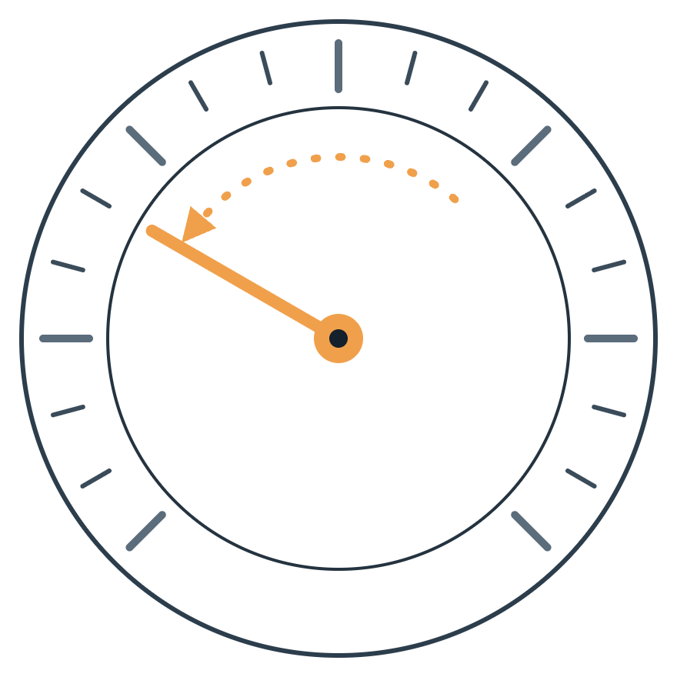
Catching meter fraud
FRAUD DETECTION · ELECTRICITY & GAS BILLING
The model got better when we looked at changes, not levels.
135,493
4.48M
0.796 → 0.872
clients
invoices
test AUC, baseline to final model
Notes:
Open with the one-line story: we tried to catch meter fraud, and the model only got meaningfully better once we stopped feeding it static values and started describing how each client’s behaviour changes over time. The three numbers at the bottom are the whole talk in miniature: 135k clients, 4.5M invoices, and test AUC from 0.796 to 0.872.

Slide 2



Some clients tamper with their meters
01 · THE CASE
The problem
The constraint
Our output
Tampered meters mean energy is used but never billed. Every fraud the utility misses is lost revenue.
Inspections cost staff and time. The utility cannot send someone to every one of its clients.
A fraud probability for every client, ranked so inspectors visit the riskiest first.
Audience: revenue-protection and inspection teams
Decision: which clients to inspect next
Catching meter fraud
2
Notes:
A utility (electricity and gas) loses money when clients tamper with meters: consumption happens but is never billed. Inspections are expensive, so the real question is not “who is a fraudster” but “who should we inspect first”. That is why our output is a probability per client that can be sorted into an inspection list. Audience: the revenue-protection and inspection teams who plan the visits.

Slide 3

Two tables: clients and their invoices
02 · THE DATA
CLIENTS TABLE
INVOICES TABLE
135,493
4,476,749
rows · 6 columns · one row per client
client_id
rows · 16 columns · one row per bill
Holds the fraud label (target)
Meter readings and consumption
district · client category · region · creation date · target
1 to many
invoice date · tariff type · meter number, status & code · reading remark · coefficient · consumption levels 1–4 · old & new index · months billed · ELEC / GAS
Every client has invoices: median 30 (min 1, max 439). We summarise them into one row per client.
First hunches: where a client lives (region) and how much they consume.
Catching meter fraud
3
Notes:
Two tables linked by client_id. The client table has 135,493 clients, one row each, and carries the label we predict. The invoice table has almost 4.5 million rows: one per bill, with meter readings (old and new index), four consumption levels, tariff, meter status and the reader’s remark. Each client has between 1 and 439 invoices, median 30. Because we predict per client, every invoice feature is summarised to one row per client. Our first hunches were location and consumption; the rest of the talk shows which signals actually mattered. Data notes: 13 invoices had the letter “A” in the meter status column; we treated those as missing. Three near-duplicate columns (tarif_type, new_index, disrict) are left out of every model, baseline included; slide 11 explains why.

Slide 4
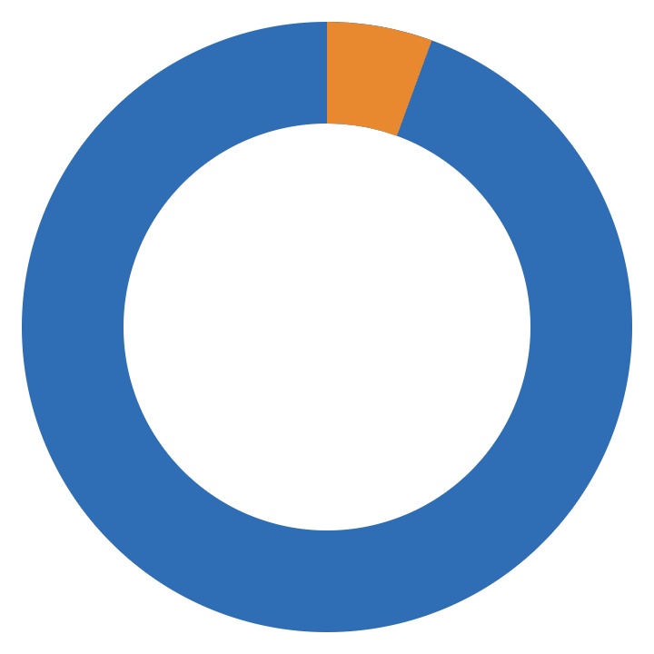
Fraud is rare, so we judge models by AUC
03 · HOW WE MEASURE
AUC, in plain words
94.4% honest
5.6%
blue in the ring
Pick one fraud client and one honest client at random. AUC is the chance that the model gives the fraud client the higher risk score.
are fraud
5.6% fraud
orange · about 1 in 18 clients
0.5 coin flip
1.0 perfect ranking
It rewards putting risky clients first, which is exactly what an inspection list needs.
A model that never flags anyone is already 94.4% accurate, and catches no fraud at all.
Catching meter fraud
4
Notes:
Only 5.58% of clients are labelled as fraud, about one in eighteen. That makes accuracy useless: a “model” that says nobody is a fraudster scores 94.4% accuracy and catches nothing. So we use AUC. In plain words: take one random fraud client and one random honest client; AUC is the probability the model ranks the fraud client higher. 0.5 means a coin flip, 1.0 means a perfect ranking. Since the business output is a ranked inspection list, a ranking metric is the right yardstick.

Slide 5

Tuning the baseline barely moved the score
04 · BASELINE AND ATTEMPT 1
BASELINE · LIGHTGBM
ATTEMPT 1 · TUNING
Raw data, default settings
A grid of 36 combinations
0.796
0.797
test AUC · train AUC 0.872
test AUC, +0.0004 · train AUC 0.871
Client columns plus each invoice column averaged per client: the number to beat.
Best (3-fold CV): learning rate 0.1 and 100 trees, LightGBM’s own defaults.
The settings were not the bottleneck; the inputs were. So we turned to feature engineering.
All models scored on the same hold-out set: 33,874 clients (25%, stratified)
5
Notes:
Baseline: LightGBM with default settings, as suggested in the challenge description, on the raw data only. The model needs one row per client, so each raw invoice column is simply averaged per client; no new ideas added. The three near-duplicate columns (tarif_type, new_index, disrict) are already left out here, as in every model. Test AUC 0.796 is the number to beat. Attempt 1: a grid search over learning rate (0.01, 0.1, 0.2, 1), number of trees (10, 100, 200) and bin sample size (1k, 10k, 20k), 36 combinations with 3-fold cross-validation. Test AUC moved by only 0.0004 (0.796 to 0.797), and the best learning rate and tree count turned out to be LightGBM’s defaults. Conclusion: tuning was not where the gains were. Every model in this talk is scored on the same 25% hold-out set of 33,874 clients, split once up front and stratified so the fraud share is identical.

Slide 6
Fraudsters tamper with meters, so we stopped looking at levels and started looking at change.
ATTEMPT 2 · FEATURE ENGINEERING
01
02
03
04
Reading remark
Tariff switches
Meter running backwards
Consumption pattern
The meter reader’s code, used as it comes
How many tariff types a client has had
Zero bills, and drops over time
A new reading lower than the old one
Notes:
This is the turning point of the story. We discussed how fraud actually happens: people tamper with meters. A tampered meter does not necessarily show a strange level of consumption, but it shows a strange change: tariffs that switch, readings that go backwards, bills that drop to zero. So instead of feeding the model static values, we built features that describe change. The reading remark is the exception: it is a raw column we used as it comes, but it turned out to be informative on its own. The next four slides take each signal in turn, each with a quick check of the fraud rate by group.

Slide 7
Reading remarks already separate risk
SIGNAL 1 · RAW COLUMN, USED AS IT COMES
Fraud rate among clients with at least one invoice carrying the remark code
Code 8
35×
7.25%
95,591 clients
Code 9
6.37%
116,596 clients
higher fraud rate for code 8 (7.25%) than for code 7 (0.21%)
Code 6
5.97%
119,781 clients
The meter reader assigns a code at every visit. We use it as it comes, no engineering needed.
Code 7
0.21%
478 clients
Codes 5, 203, 207 and 413 cover 1–2 clients each, none of them fraud.
Average fraud rate across all clients: 5.58%
Catching meter fraud
7
Notes:
Before engineering anything, one raw column stood out: reading_remarque, a code the meter reader assigns at each reading. Clients who ever received code 8 have a 7.25% fraud rate, well above the 5.58% average, while code 7 sits at 0.21%, roughly 35 times lower. A client can receive several codes over time, so the client counts overlap. We feed this column to the model as it is; the point of this slide is that the reader on site already notices something.

Slide 8
More tariff switches, more fraud
SIGNAL 2 · TARIFF SWITCHES
55.6%
Switching tariffs is a warning sign
17.9%
One tariff: 3.9% fraud. Three to five tariffs: 11–18%, two to three times the average.
11.3%
12.0%
7.1%
X["n_tarif_types"] =
3.9%
by_client["tarif_type"].nunique()
Also added: number of meters and number of invoices per client.
1
2
3
4
5
6
70,837
60,466
3,701
424
56
9
Average 5.58% · x-axis: tariff types per client, with client counts · 55.6% bar cut to fit
Catching meter fraud
8
Notes:
For every client we count how many different tariff types appear across their invoices. Clients who stayed on one tariff have a 3.9% fraud rate, below the 5.58% average. Two tariffs: 7.1%. Three to five: 11 to 18%. Six tariffs reaches 55.6%, but that is only 9 clients, so treat it as anecdotal; the bar is cut to keep the chart readable. Alongside this we added the number of distinct meters and the number of invoices per client.

Slide 9
Meters running backwards double the risk
SIGNAL 3 · METER RUNNING BACKWARDS
40.0%
New reading lower than the old one
Only 1,816 clients ever show it, but their fraud rate is about 11%, twice the average.
11.3%
11.0%
negative = diff_index < 0
X["n_negative_diff"] =
5.5%
negative.groupby(client).sum()
X["share_negative_diff"] =
0
1
2–5
6+
negative.groupby(client).mean()
133,677
1,519
292
5
Average 5.58% · x-axis: invoices where the index went backwards, with client counts
Count and share: 1 of 1 invoices is not the same as 1 of 50.
Catching meter fraud
9
Notes:
A meter index should only go up. When the new reading is lower than the old one, something happened to the meter. We count, per client, how many invoices show this, and what share of their invoices it is, because one backwards reading out of one invoice is very different from one out of fifty. It is rare: 1,816 clients in total. But a single backwards reading already doubles the fraud rate, to about 11%, and the 5 clients with six or more reach 40%. The code on the slide is simplified; diff_index is new index minus old index per invoice.

Slide 10
Zero bills signal risk, drops alone do not
SIGNAL 4 · CONSUMPTION PATTERN
Zero-consumption bills
Later vs earlier invoices
Has zero bills
7.17%
Consumption change | Clients | Fraud rate
Drop over 50% | 16,223 | 4.89%
Drop 10–50% | 31,275 | 6.16%
Stable (±10%) | 25,973 | 4.40%
Increase over 10% | 62,022 | 5.97%
72,626 clients
Never zero
3.75%
62,867 clients
Average fraud rate: 5.58%
1.9×
the fraud rate when a client has at least one zero-consumption bill
change = (late − early) / (early + 1)
No clean “tampered meter” drop on its own. We kept it as a model input.
Catching meter fraud
10
Notes:
We added up the four consumption levels per invoice and summarised them per client: mean, spread, minimum and the share of zero-consumption bills. The zero bills are a clear signal: clients with at least one zero bill have a 7.17% fraud rate against 3.75% for those who never had one, almost twice as high. We also expected the classic tampered-meter shape, a drop between the earlier and the later half of a client’s invoices. Honest result: on its own it shows no clean pattern; a drop over 50% is even slightly below average. We kept it as an input because the model can still combine it with other features, but we did not score it separately.

Slide 11
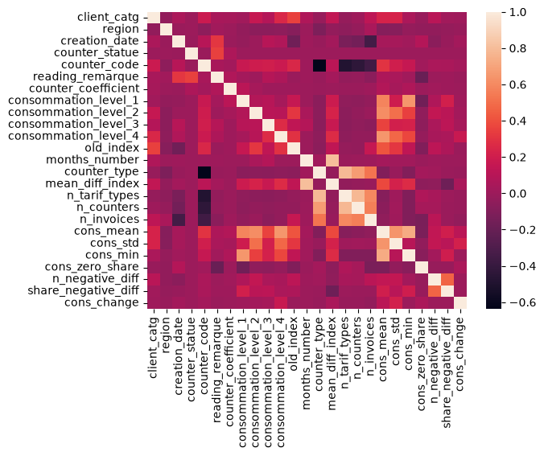
3 columns dropped, 11 features added
FEATURE SET · WHAT CHANGED
Dropped: near-duplicates
tarif_type
99.6% correlated with counter_type, which we keep
new_index
99.3% correlated with old_index; their difference became a feature
disrict
a coarser version of region, which we keep
Tested but kept: counter_code and counter_statue. Dropping them flagged about 800 more honest clients.
Added: 11 engineered features
Meter index
mean_diff_index · n_negative_diff · share_negative_diff
Tariffs & meters
n_tarif_types · n_counters · n_invoices
Correlation of the final 25 features
Consumption
cons_mean · cons_std · cons_min · cons_zero_share · cons_change
The drops apply to every model, baseline included
11
Notes:
A summary of the feature set. Dropped: three columns that repeat information already in the data. tarif_type is 99.6% correlated with counter_type, so we keep counter_type; the number of tariff types per client is still built as a feature. new_index is 99.3% correlated with old_index; what matters is their difference, which we built as a feature. disrict is a coarser version of region. We also tried dropping counter_code and counter_statue, but the model then flagged about 800 more honest clients, so they stay, together with the four consumption levels. Added: eleven engineered features in three groups: meter index (average index difference, count and share of backwards readings), tariffs and meters (number of tariff types, meters and invoices per client), and consumption (mean, spread, minimum, share of zero bills, change from earlier to later invoices). The heatmap shows the final 25 features: no 99%-level duplicates remain; the strongest remaining pairs are among the per-client counts and the consumption summaries.

Slide 12
Features lifted test AUC by 0.076
05 · RESULTS
Train AUC
Test AUC
Axis starts at 0.5 (coin flip)
+0.076
0.916
0.917
0.872
0.871
0.873
0.872
test AUC from the new features (0.796 → 0.872)
0.796
0.797
≈ 0
from tuning, with or without the features
The train–test gap shrank from 0.075 to 0.046, so the new features also generalise better.
1 Baseline
2 Baseline + tuning
3 Features
4 Features + tuning
Same hold-out set of 33,874 clients for every model
12
Notes:
The KPI ladder. Baseline: test AUC 0.796. Tuning the baseline: 0.797, a gain of only 0.0004. Adding the engineered features with default settings: 0.873. Tuning on top of the features gives 0.872, slightly lower, so tuning adds nothing in either case; the final model (features + tuning, 0.872) is the one used on the next slide. The gain from the features is +0.076 either way. Reading train against test: the baseline scores 0.872 on training data but 0.796 on unseen clients, a gap of 0.075, a sign of overfitting to noise. With the features, the gap shrinks to 0.046, so the model learned patterns that hold for new clients. Both test scores are well above 0.5, so this is not underfitting. Cross-validated AUC of the final model during the search was 0.862, close to the test score. We did not score each feature group separately; that ablation is a next step.

Slide 13
Catching 72% of fraud has a price
06 · FROM SCORES TO INSPECTIONS
Test set, chosen setup (weighting + cut-off 0.547)
Same final model, three ways to flag clients
Flagged
Not flagged
Setup | Fraud caught | Recall | Precision | Honest flagged
Model 4, cut-off 0.5 | 179 | 9.5% | 58.9% | 125
+ fraud weighting, cut-off 0.5 | 1,441 | 76.2% | 19.3% | 6,030
+ weighting, cut-off 0.547 (chosen) | 1,369 | 72.4% | 21.2% | 5,080
1,369
523
Fraud
caught
missed
5,080
26,902
Honest
wrongly flagged
correctly cleared
About 1 in 5 inspections finds fraud, against 1 in 18 at random.
At the default 0.5 cut-off the model is cautious and finds only 1 in 10 fraudsters. Weighting fraud in training plus a cut-off picked on training data (target: catch 70%) finds nearly 3 in 4.
Test set: 1,892 fraud and 31,982 honest clients
Catching meter fraud
13
Notes:
AUC tells us how well the model ranks; this slide is about where to draw the line. With the default rule, flag a client only when the model is more than 50% sure, the model flags few people: it is right 59% of the time but catches only 179 of 1,892 fraudsters, under 10%. Two changes: fraud weighting, which makes a missed fraudster cost more during training, and a lower bar for flagging, chosen on training data with out-of-fold predictions so the test set stays untouched; the target was to catch 70% of fraud, which gave a cut-off of 0.547. Result: 1,369 fraudsters caught, 72%, at the price of 5,080 honest clients flagged. Still, about one in five inspections finds fraud, compared with one in eighteen when picking clients at random. Where exactly to put the cut-off is a business decision: inspection capacity and the cost of a visit versus a missed fraud.

Slide 14



From model to a weekly inspection list
07 · RECOMMENDATIONS
The data product
Recommendations
Next steps
A ranked list of clients by fraud risk, refreshed weekly
Inspectors start at the top and work down
At the chosen cut-off, about 1 in 5 visits finds fraud
Set the cut-off by inspection capacity and the cost of a missed fraud
Treat backwards readings and frequent tariff changes as red flags
Record inspection outcomes and feed them back as labels
Score each feature group on its own (ablation)
Add data, such as past inspection results
Try other algorithms, such as XGBoost or CatBoost
Calibrate scores, since weighting distorts probabilities
Catching meter fraud
14
Notes:
The data product is simple: every week, score all clients and hand the inspection team a list sorted by fraud risk. They work from the top down as far as their capacity allows. At the cut-off we chose, roughly one visit in five finds fraud, nearly four times better than random visits. Recommendations: let the business set the cut-off from inspection capacity and the cost of a missed fraud; use the strongest signals, backwards readings and frequent tariff changes, as red flags even outside the model; and record every inspection outcome so the model keeps learning. Next steps: measure each feature group on its own to see exactly which one carries the gain, add data such as past inspections, try other gradient-boosting libraries, and calibrate the scores so they can be read as real probabilities.

Slide 15
Thank you
IN ONE LINE: LOOK AT CHANGE, NOT LEVELS
Questions?
0.796 → 0.872
≈ 0 vs +0.076
72%
test AUC, baseline to final model
tuning vs new features
of fraud caught at the chosen cut-off
Notes:
Close with the one-line summary: tuning the model gave practically nothing (+0.0004), describing how clients’ behaviour changes gave +0.076, and at the chosen cut-off the model catches 72% of fraud with about one in five inspections hitting a real case. Then open the floor for questions. Likely questions: why AUC and not accuracy (slide 4), which single feature helped most (not measured separately yet; ablation is a next step), and whether the model overfits (train–test gap shrank, slide 12).

